Slide 1
Topics: Strings – Chapter 13
Today:
String library functions
Array of Strings
Command-Line Arguments
Previously:
String literals
String variables

Slide 2
Introduction
Two types of strings:
string constants (or literals, as they’re called in the C standard)
string variables
Strings are not a type in C .
Strings are arrays of characters in which a special character—the null character—marks the end.
The C library provides a collection of functions for working with strings.

Slide 3
Using the C String Library

Slide 4
Using the C String Library
Strings are treated as arrays in C, so they’re restricted in the same ways as arrays.
In particular, they can’t be copied or compared using operators.
The C library provides a rich set of functions for performing operations on strings.
Programs that need string operations should contain the following line:
#include <string.h>

Slide 5
String Library Functions
Compare strings
strcmp
Length of a string
strlen
Copy strings
strcpy
strcat
Search and tokenize strings
strstr
strtok

Slide 6
Using the C String Library
Direct attempts to copy or compare strings will fail.
Copying a string into a character array using the = operator is not possible:
char str1[10]= "abc";
char str2[10]= "def";
str2 = str1; /*** WRONG ***/
Using an array name as the left operand of = is illegal

Slide 7
Using the C String Library
Attempting to compare strings using a relational or equality operator is legal but won’t produce the desired result:
if (str1 == str2) … /*** WRONG ***/
str1 and str2 are compared as pointers.
Since str1 and str2 have different addresses, the expression str1 == str2 must have the value 0.

Slide 8
The strcmp (String Comparison) Function
Prototype for the strcmp function:
int strcmp(const char *s1, const char *s2);
strcmp compares the strings s1 and s2, returning a value less than, equal to, or greater than 0.
To test whether str1 and str2 contain the same characters:
if(strcmp(str1, str2)==0) …

Slide 9
The strcmp (String Comparison) Function
As it compares two strings, strcmp looks at the numerical codes for the characters in the strings.
Some knowledge of the underlying character set is helpful to predict what strcmp will do.
Important properties of ASCII:
A–Z, a–z, and 0–9 have consecutive codes.
All upper-case letters are less than all lower-case letters.
Digits are less than letters.
Spaces are less than all printing characters.

Slide 10
The strcmp (String Comparison) Function
strcmp considers s1 to be less than s2 if either one of the following conditions is satisfied:
The first i characters of s1 and s2 match, but the (i+1)st character of s1 is less than the (i+1)st character of s2. For example, s1: "back", s2: "bag"
All characters of s1 match s2, but s1 is shorter than s2. For example, s1: "be", s2: "bee"

Slide 11
Exercise
Is strcmp("he", "hi")< 0 or >0?
Is strcmp("hello", "Hi")< 0 or >0?
Is strcmp("he", "hello")< 0 or >0?
Is strcmp(“8h", "hello")< 0 or >0?

Slide 12
The strlen (String Length) Function
Prototype for the strlen function:
size_t strlen(const char *s);
size_t is a type defined in string.h that represents one of C’s unsigned integer types.
12

Slide 13
The strlen (String Length) Function
strlen returns the length of a string s, not including the null character.
Examples:
int len;
len = strlen("abc"); /* len is now 3 */
len = strlen(""); /* len is now 0 */
13

Slide 14
The strcpy (String Copy) Function
Prototype for the strcpy function:
char *strcpy(char *s1, const char *s2);
strcpy copies the string pointed to by s2 into the array pointed to by s1.
strcpy returns s1 (a pointer to the destination string).
strcpy(str2, "abcd");
/* str2 now contains "abcd" */
strcpy(str1, str2);
/* str1 now contains "abcd" */

Slide 15
The strcat (String Concatenation) Function
Prototype for the strcat function:
char *strcat(char *s1, const char *s2);
strcat appends the contents of the string s2 to the end of the string s1.
It returns s1 (a pointer to the resulting string).

Slide 16
The strcat (String Concatenation) Function
strcat examples:
strcpy(str1, "abc");
strcpy(str2, "def");
strcat(str1, str2);
/* str1 now contains "abcdef" */

Slide 17
Exercise
What will be the value of string s1 after the following statements have been executed?
strcpy(s1, “String”);
strcpy(s2, “Library”);
if (strcmp(s1, s2) < 0)
strcat (s1, s2);
else
strcat(s2, s1);
String
Library
StringLibrary
LibraryString
None of the above

Slide 18
Array of Strings

Slide 19
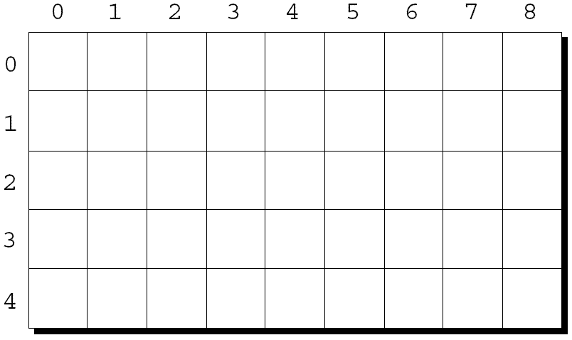
Multidimensional Arrays
The following declaration creates a two-dimensional array (a matrix, in mathematical terminology):
int m[5][9];
m has 5 rows and 9 columns. Both rows and columns are indexed from 0:

Slide 20
Multidimensional Arrays
To access the element of m in row i, column j, we must write m[i][j].
The expression m[i] designates row i of m, and m[i][j] then selects element j in this row.

Slide 21
Arrays of Strings
To create an array of strings with initial values, use a two-dimensional array of characters, with one string per row:
char planets[][8] = {"Mercury", "Venus", "Earth",
"Mars", "Jupiter", "Saturn",
"Uranus", "Neptune"};
The number of rows in the array can be omitted, but C requires that we specify the number of columns.
21

Slide 22
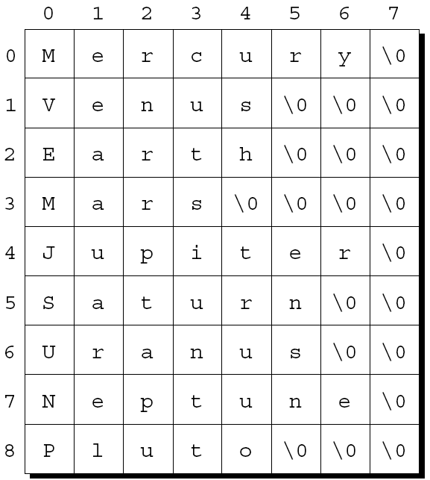
Arrays of Strings
The planets array contains a fair bit of wasted space (extra null characters), but it can be modified:
planets[0][2] = ‘k’;
22

Slide 23
Arrays of Strings
We can also create array in C by whose elements are string literals (read only):
char *planets[] = {"Mercury", "Venus", "Earth",
"Mars", "Jupiter", "Saturn",
"Uranus", "Neptune"};
23

Slide 24
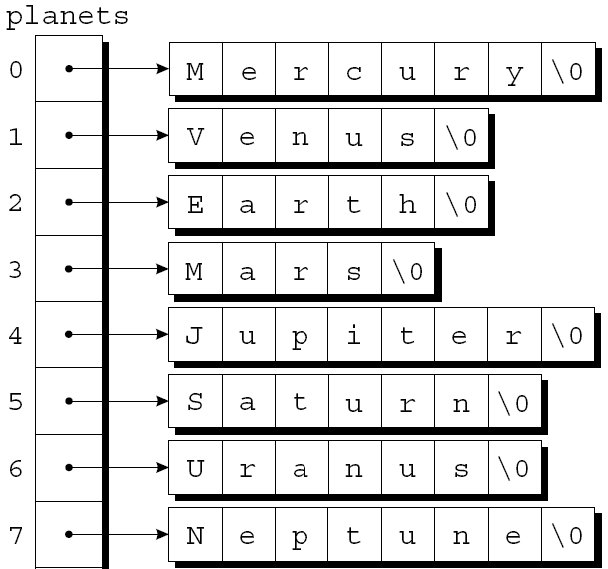
Arrays of Strings
How planets is stored:
24

Slide 25
Arrays of Strings
To access one of the planet names, all we need do is subscript the planets array.
A loop that prints the planets array:
for (i = 0; i < 8; i++)
printf("%s\n", planets[i]);
25

Slide 26
Exercise
An array of strings is defined as:
char *planets[] = {"Mercury", "Venus", "Earth", "Mars", "Jupiter", "Saturn", "Uranus", "Neptune", "Pluto"};
What’s the value of planets[3]?
‘c’
"Mars"
"Earth"
"Uranus"
None of the above

Slide 27
Exercise
An array of strings is defined as:
char *planets[] = {"Mercury", "Venus", "Earth", "Mars", "Jupiter", "Saturn", "Uranus", "Neptune", "Pluto"};
What’s the value of planets[2][2]?
‘e’
‘u’
‘r’
‘a’
None of the above

Slide 28
Command-Line Arguments

Slide 29
Command-Line Arguments
When we run a program, we’ll often need to supply it with information.
This may include a file name or a switch that modifies the program’s behavior.
Examples of the UNIX ls command:
ls -l remind.c
To obtain access to command-line arguments, main must have two parameters:
int main(int argc, char *argv[])
{
…
}
29

Slide 30
Command-Line Arguments
argc (“argument count”) is the number of command-line arguments.
argv (“argument vector”) is an array of pointers to the command-line arguments (stored as strings).
argv[0] points to the name of the program, while argv[1] through argv[argc-1] point to the remaining command-line arguments.
30

Slide 31
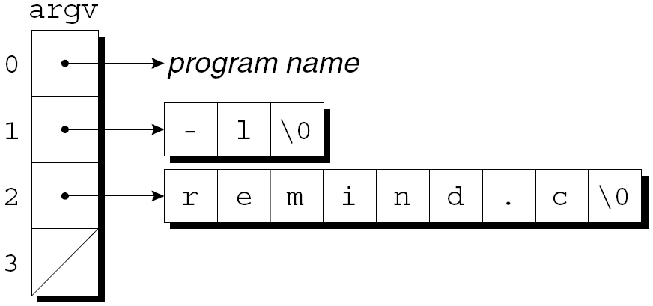
Command-Line Arguments
If the user enters the command line
ls -l remind.c
then argc will be 3, and argv[0] will be “ls”, argv[1] will be “-l” argv[2] will be “remind.c”.
31

Slide 32
Command-Line Arguments
Typically, a program that expects command-line arguments will set up a loop that examines each argument in turn.
One way to write such a loop is to use an integer variable as an index into the argv array:
int i;
for (i = 1; i < argc; i++)
printf("%s\n", argv[i]);
32

Slide 33
Exercise
If the user enters the command line
./a.out 8 24 52 81 23
What is argv[3]?
24
52
81
8 24 52

Slide 34
Example Program
Compare if a command-line argument is one of the planets

Slide 35
Exercise: Command-Line Arguments
Write a program named command_sort.c that sorts its command-line arguments, which are assumed to be integers. Use the selection_sort function in selection_sort.c
Test the program by typing
./a.out 8 24 52 81 23
Use atoi function in <stdlib.h> to convert a string to integer form. For example, if a string variable s contains “8”. Then atoi(s) returns 8.

